Slide 1
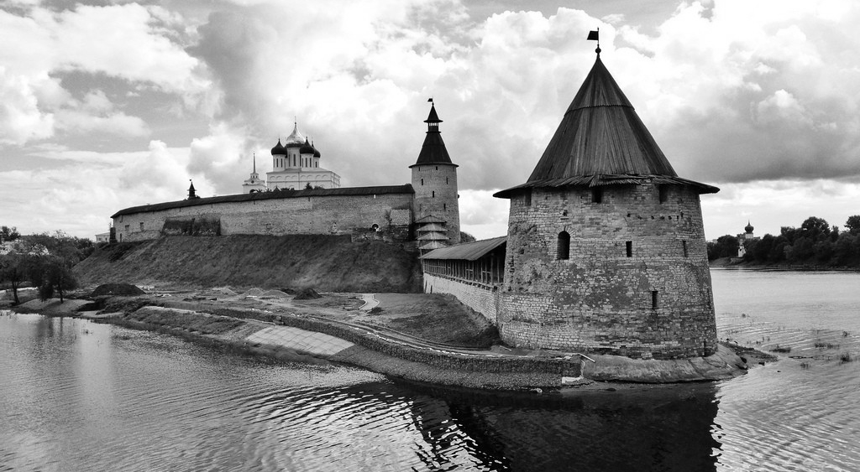
MEDICAL TOURISM
IN THE PSKOV REGION
LEARN HOW TO GET MEDICAL CARE IN THE PSKOV REGION

Slide 2
CONTANTS
2
Medical treatment in Russia. How does it work? 3-6
Step I: Choose a health facility 7-9
Step II: Contact a specialist from a chosen health
Facility 10-11
Step III: Transportation and accommodation 12-15
Step IV: Apply for a visa 16-20
Step V: Welcome to Russia! 21-22
Contact information 23
Materials prepared by
Export of Medical Services Coordination Center
Federal Research Institute for Health organization and informatics of the Ministry of Health of the Russian Federation

Slide 3
3
MEDICAL TREATMENT
IN PSKOV REGION.
HOW DOES IT WORK?

Slide 4
MEDICAL TREATMENT IN PSKOV REGION IS
4
HIGH QUALITY
THE BEST DOCTORS
LOW COST
RUSSIAN CULTURE
High quality medical care
Meeting international standards
Highly trained doctors, nurses and other medical specialists with
an international experience
Medical care in Russia has an excellent
cost-to-quality ratio
Discover rich national cultural heritage and history

Slide 5
5
GETTING MEDICAL TREATMENT IN RUSSIA
IN THE RUSSIAN FEDERATION THERE ARE OUTPATIENT MEDICAL CARE AND INPATIENT MEDICAL CARE. HEALTHCARE FACILITY SPECIALISTS WILL PROVIDE ASSISTANCE WITH CHOOSING
THE TYPE OF MEDICAL CARE YOU NEED.
OUTPATIENT MEDICAL CARE
INPATIENT MEDICAL CARE
GET YOUR HEALTH CHECK-UP WITHIN
2-3 DAYS WHILE YOU ARE ON VACATION
CHOOSE A HEALTH FACILITY ACCORDING TO THE MEDICAL PROCEDURE YOU ARE SEEKING
AND COME TO RUSSIA FOR HOSPITAL ADMISSION
Check a healthcare facility website for more information
Check a healthcare facility website for more information

Slide 6
6
HOW TO GET MEDICAL CARE
IN THE PSKOV REGION?
STEP I
Choose
a health facility
STEP II
Get confirmation
from chosen healthcare facility
STEP III
Select type
of transportation
and accommodation
STEP IV
Apply for
a visa
STEP V
Welcome to Russia!

Slide 7
7
STEP I
CHOOSE THE BEST HEALTH FACILITY ACCORDING TO THE MEDICAL PROCEDURE YOU ARE SEEKING

Slide 8
8
CHOOSE YOUR
PSKOV MEDICAL
RESEARCH CENTERS
GBUZ PO «Pskov Regional Clinical Hospital»
https://pskovokb.ru/
GBUZ PO «Velikiye Luki interdistrict hospital»
https://vlkcgb.ru
GYNECOLOGY AND OBSTETRICS
CARDIOLOGY
TRAUMATOLOGY AND ORTHOPEDICS
GBUZ PO «Pskov Regional Clinical Hospital»
https://pskovokb.ru/
GBUZ PO «Velikiye Luki interdistrict hospital»
https://vlkcgb.ru/
GBUZ PO «Pskov Perinatal Center»
http://www.pskovrody.ru/
Pskov
Pskov
Pskov
Velikiye Luki
Velikiye Luki
STOMATOLOGY
COSMETOLOGY
NEUROLOGY AND NEUROSURGERY
GAUZ PO «Dental clinic»
http://pskovoblstom.ru/
GAUZ PO «Velikiye Luki Dental Clinic»
https://stomavl.ru/
GBUZ PO «Dermatovenerologic dispensary of the Pskov region»
https://pskovkvd.moy.su/
GBUZ PO «Pskov Regional Clinical Hospital»
https://pskovokb.ru/
Pskov
Velikiye Luki
Velikiye Luki
Pskov
Pskov

Slide 9
9
CHOOSE YOUR
PSKOV MEDICAL
RESEARCH CENTERS
CHOOSE YOUR
PSKOV MEDICAL
RESEARCH CENTERS
THERAPY
REHABILITATION
ENDOCRINOLOGY
GBUZ PO «Pskov Regional Clinical Hospital»
https://pskovokb.ru/
GBUZ PO «Velikiye Luki interdistrict hospital»
https://vlkcgb.ru/
GBUZ PO «Pskov Regional Clinical Hospital»
https://pskovokb.ru/
GBUZ PO «Pskov Regional Clinical Hospital»
https://pskovokb.ru/
GBUZ PO «Velikiye Luki interdistrict hospital»
https://vlkcgb.ru/
Pskov
Pskov
Pskov
Velikiye Luki
PSYCHIATRY
Velikiye Luki
GBUZ PO «Pskov Regional Psychiatric Hospital No. 1»
http://bogdanovo-pskov.ru /
Pskov

Slide 10
10
STEP II
CONTACT A SPECIALIST FROM YOUR CHOSEN HEALTH FACILITY TO DECIDE ON THE FORM
OF MEDICAL TREATMENT YOU NEED AND FOR PREPARING DOCUMENTS FOR YOUR VISIT
TO RUSSIA

Slide 11
1. CHECK THE SECTION "MEDICAL TOURISM” ON THE HEALTH CARE FACILITY WEB-SITE
2. READ THE INFORMATION
3. MAKE A REQUEST THROUGH A PHONE CALL OR EMAIL
4. GET A CONFIRMATION FOR TREATMENT AND FOLLOW
THE INSTRUCTIONS TO APPLY FOR A VISA
11
If you have any questions do not hesitate to contact Export of Medical Services Coordination Center

Slide 12
12
STEP III
SELECT THE BEST TYPE OF TRANSPORTATION AND ACCOMMODATION

Slide 13
13
T R A N S P O R T A T I O N
PUBLIC TRANSPORTATION
ROUTES AND FLIGHT SCHEDULES
HTTPS://AZIMUTH.AERO/RU/
2. USE TRANSPORTATION
HTTPS://WWW.PSKOVBUS.RU/
PSKOV (PKV)
PSKOV
YOU CAN GET FROM THE AIRPORT TO THE CITY BY TAXI.
THERE ARE PLENTY OF TAXI APPS (YANDEX.TAXI, UBER, GETT TAXI)
DON'T FORGET TO DOWNLOAD THEM BEFORE YOUR JOURNEY.
PSKOV RAILWAY STATION
TAXI
PUBLIC TRANSPORTATION
USE TRANSPORTATION
HTTP://WWW.VELIKIELUKI.RU/
VELIKIYE
LUKI
RAILWAY STATION
VELIKIYE
LUKI
YOU CAN GET FROM THE AIRPORT TO THE CITY BY TAXI.
THERE ARE PLENTY OF TAXI APPS (YANDEX.TAXI, UBER, GETT TAXI)
DON'T FORGET TO DOWNLOAD THEM BEFORE YOUR JOURNEY.
TAXI

Slide 14
TRAVEL APPs
to download before your trip
FOR IOS and ANDROID
14
Public transportation and car rental (car sharing)
City maps
Attractions in Russia
1. Bus:
Yandex.Transport
1. Russian city maps:
Yandex.Maps
Google maps
2. Off-line Russian city maps:
2GIS
City guide Apps:
Triposo
Redigo
2. Restaurant guide App:
TripAdvisor

Slide 15
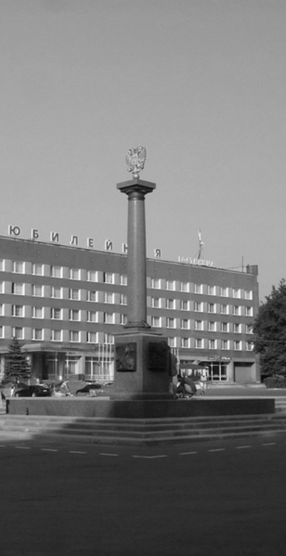
15
ACCOMMODATION
ACCOMMODATION OPTIONS IF YOU ARE COMING FOR OUTPATIENT ADMISSION
https://www.booking.com/
https://www.tripadvisor.com/
https://www.airbnb.com/
Please contact a tour operator or assistance companies if you need any assistance with organizing your trip.
ACCOMMODATION OPTIONS IF YOU ARE COMING FOR INPATIENT ADMISSION
Contact a specialist from a health facility for information about your accommodation. Please do not forget to do it in advance.

Slide 16
16
STEP IV
APPLY FOR A RUSSIAN VISA

Slide 17
17
WHAT TYPES OF RUSSIAN VISAS ARE THERE?*
TOURIST
PURPOSE OF VISIT: TARGET TOURISM
BUSINESS
PURPOSE OF VISIT: MEDICAL TREATMENT
PRIVATE
PURPOSE OF VISIT:
SPECIAL CASES
The period of validity: up to 90 days
For those who travel to Russia for emergency medical treatment or to visit a sick relative.
The period of validity: up to 30 days
For those who visit Russia for tourism purposes on a specialized tour for health check-ups or medical consultations
The period of validity: up to 90 days
For those who visit Russia for medical treatment, health check-ups, medical advice with official invitation obtained from a health facility (except target tourism for the purpose of treatment and critical care).

Slide 18
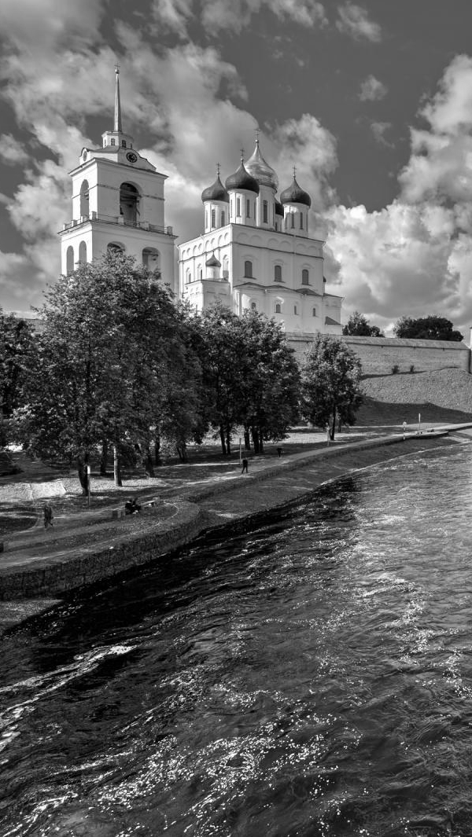
Help with processing documents for entering Russia
18
GETTING AN OFFICIAL INVITATION
Once you get an approval for treatment, the health facility should obtain an official invitation and submit your documents to the Federal Migration Service of Russia in order to register your migration.
APPLYING THROUGH TRAVEL AGENCIES
OR TRAVEL ASSISTANCE COMPANIES
In case you need additional help with applying for a Russian visa, you can contact travel agencies or travel assistance companies.

Slide 19
19
STEP V
WELCOME TO RUSSIA!
EMERGENCY TELEPHONE NUMBERS

Slide 20
20
USEFUL AND EMERGENCY TELEPHONE NUMBERS
FEDERAL MIGRATION SERVICE OF RUSSIA
EMERGENCY
POLICE
112
8 (800) 350 23 69
* 381
8 (800) 222 74 47

Slide 21
21
CONTACT INFORMATION
Export of Medical Services Coordination Center
Federal Research Institute for Health organization and informatics of the Ministry of Health of the Russian Federation
127256, MOSCOW, DOBROLYUBOVA ST., 11
EMAIL ADDRESS
OM@ROSMINZDRAV.RU
PHONE NUMBERS
+7 (495) 618-07-92*103
+7 (495) 618-07-92*104

